Slide 1
Building a Scalable Data Intelligence Platform
Dennes Torres

Slide 2







Dennes Torres Data Platform MVP (Alumni)
Dtower Software & Onyx Data
https://dtowersoftware.com
Trainer
MCT, Azure Solutions Architect, Azure Data Engineer and Azure DevOps Engineer
Malta Data Platform UG Leader
Malta
MMDPUG
https://www.facebook.com/MMDPUG
http://dennestorres.com
Dennes.Torres
@Dennes
https://br.linkedin.com/in/dennestorres
dennes@bufaloinfo.com.br
http://youtube.com/c/dennestorres

Slide 3


Slide 4
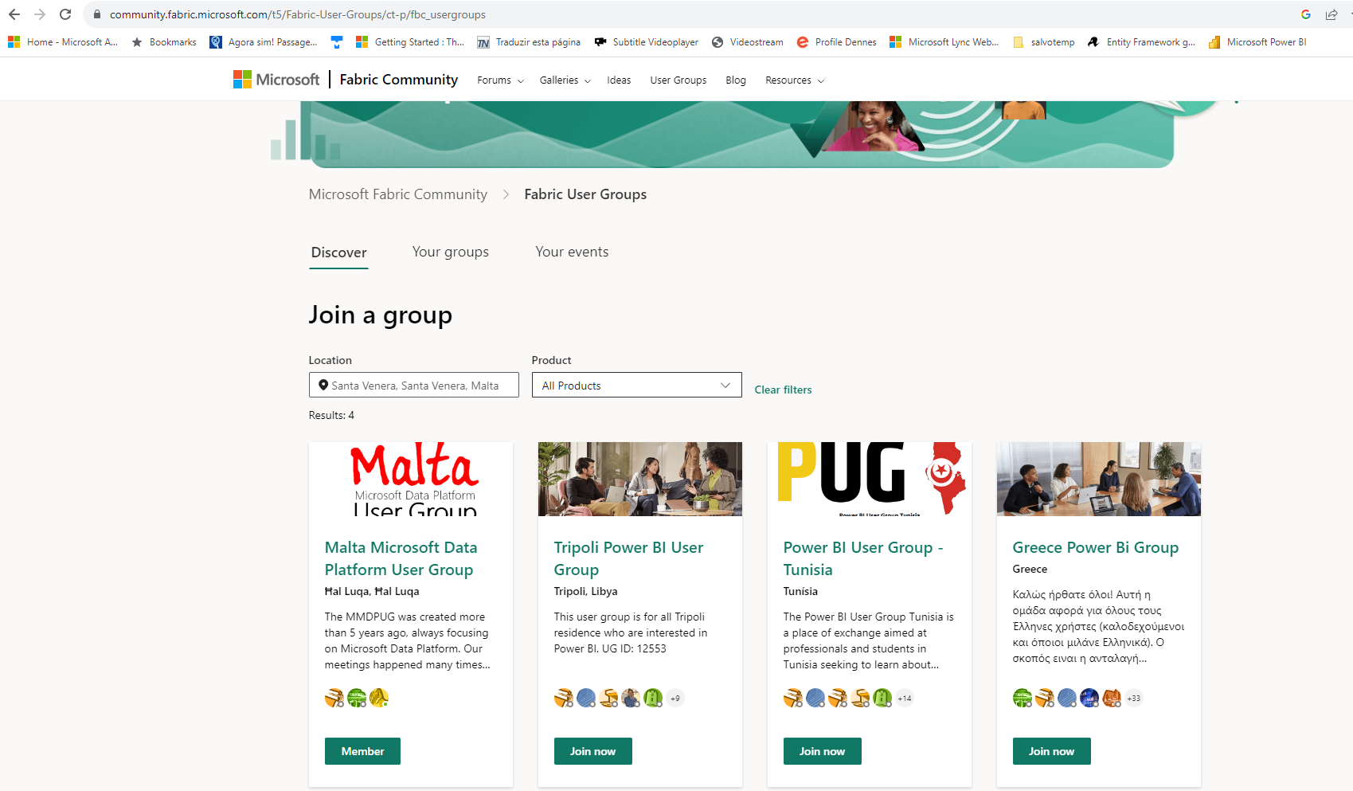

Slide 5
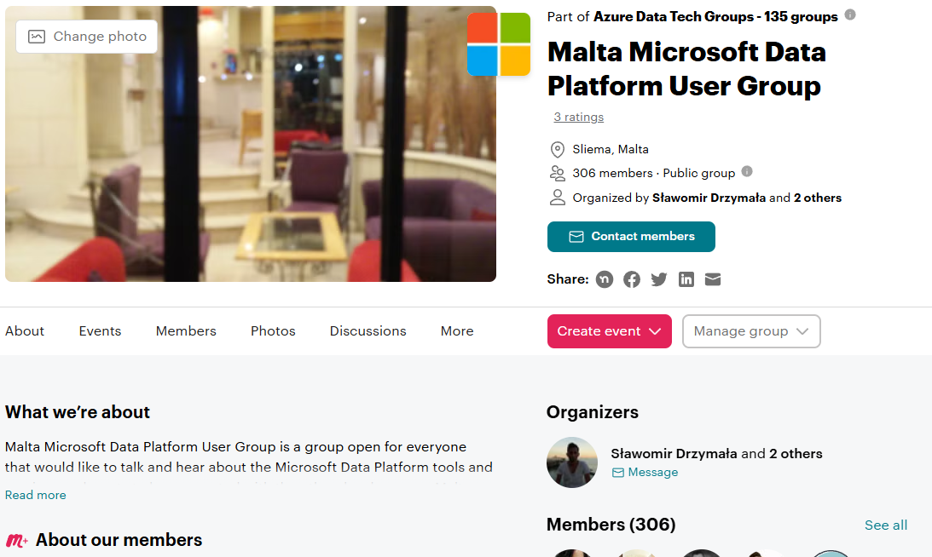

Slide 6
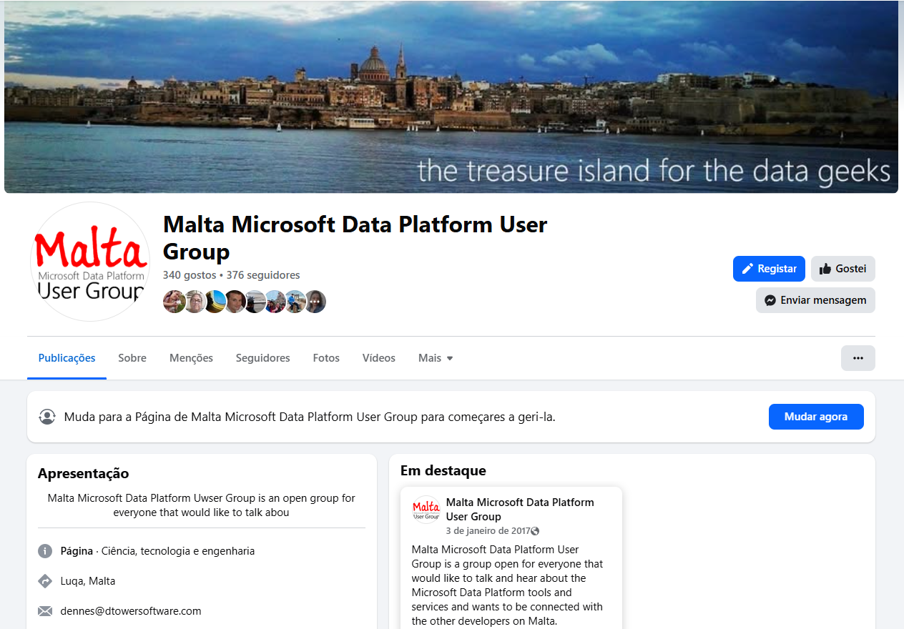

Slide 7
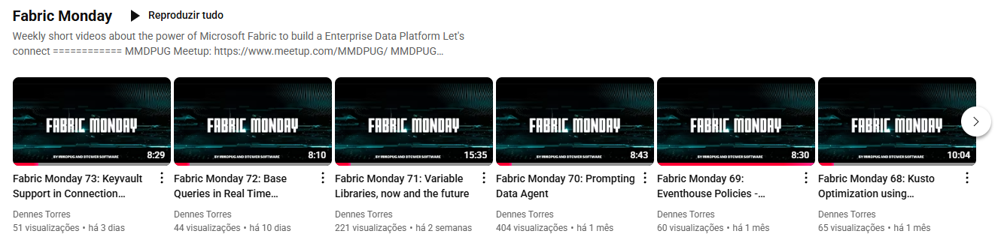
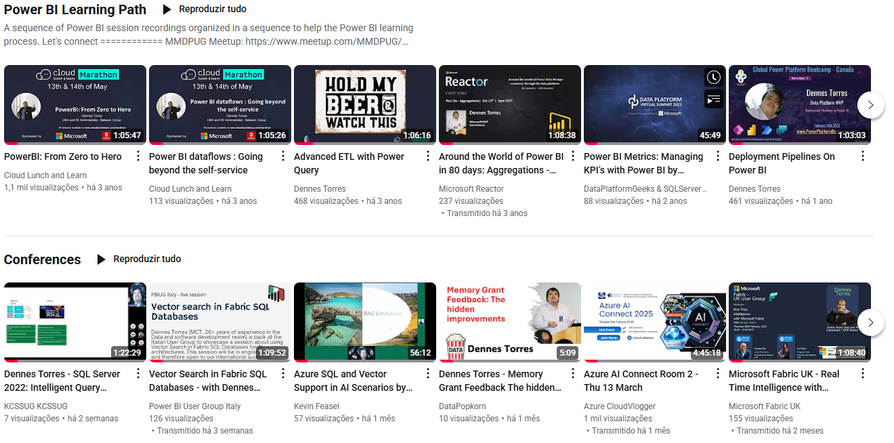

Slide 8
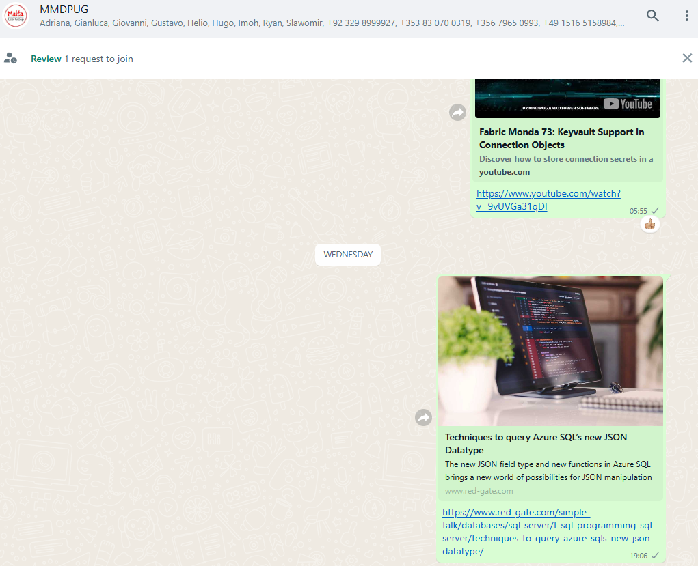

Slide 9
How to reach us
Facebook Page
https://tinyurl.com/MMDPUGPAGE
Facebook Group
https://tinyurl.com/MMDPUGGROUP
WhatsApp
https://tinyurl.com/MMDPUGCHAT
Meetup
https://www.meetup.com/MMDPUG/
Twitter
http://twitter.com/Dennes
Fabric Community
https://tinyurl.com/2674jzuc

Slide 10








Fabric Community
Facebook Page
Facebook Group
WhatsApp
Meetup
LinkedIn
Youtube
Twitter

Slide 11
Building a Scalable Data Intelligence Platform

Slide 12
The company decided to build the data platform in Fabric
What’s next?

Slide 13
Know the Scope

Slide 14
Are you sure you know the scope ?

Slide 15

Supplier & Orders
Human Resources
Accounts & Invoices
Sales

Slide 16
What May have Happened
You were asked to build the company data platform
But you forgot the other areas. Include them
You were asked to focus only on Sales
The company has an enterprise data platform with rules and definitions you need to follow
You were asked to focus only on Sales
The other areas have their own solutions in isolated silos

Slide 17
What Architecture Will You Choose

Slide 18
Main Data Platform Architecture
Single Source of Truth
The Data is centralized in a single place
The SSoT can generate Data Marts
Users consume either from SSoT or Data Marts
Data Mesh
The data is broken down in isolated domains
Each domain provide services
Services are consumed either by other domains or users

Slide 19
Single Source of Truth
Data Mesh
Supplier & Orders
Human Resources
Accounts & Invoices
Sales

Slide 20
Single Source of Truth
The team needs business knowledge about all domains
The team needs business knowledge
This is a hard task
Each domain will be ingested in sequence
Some variations may help, but not much
A backlog of requests will grow
Departments will keep producing in isolation
Instead of letting departments work in isolation, why not onboard their technical staff into the data platform, giving them guidance and guardrails to build within enterprise rules?

Slide 21
Data Mesh
It requires independent teams for each product
Business knowledge is distributed
Not all companies can implement this
It can be implemented slowly
It requires Data Platform as A Service
Fabric is almost the only platform providing this
Each data product provides services
These are services for Data Engineers
Self-Service is getting away with the idea it’s only for end users

Slide 22
Next Definitions

Slide 23
Next Definitions
Define Company Domains

Slide 24
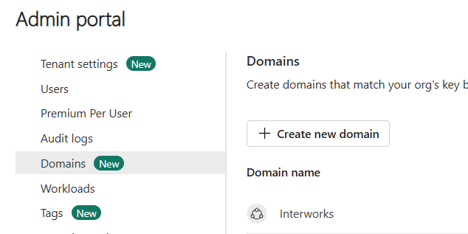
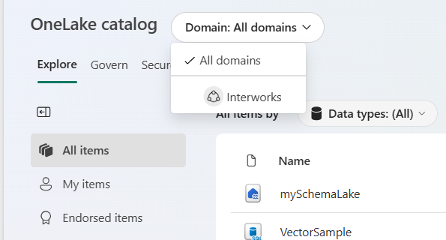
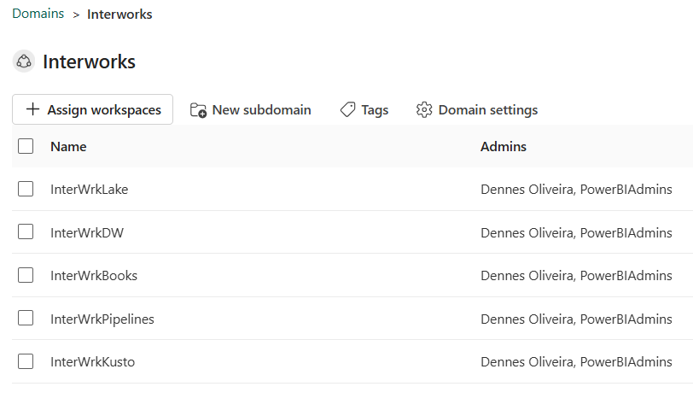
Domain Support in Fabric

Slide 25
Next Definitions
Define Company Domains
Control Delegated Security Definitions

Slide 26
Delegated Permissions
Create Fabric Objects
Data Platform as a Service made easy
Capacity Permission
A cost management team for all domains
Connection Permission Management
Best practice specification
Entra Groups
Shared with a central team
Workspace Permission Management
Best practice specification
Entra Groups
Shared with a central team

Slide 27
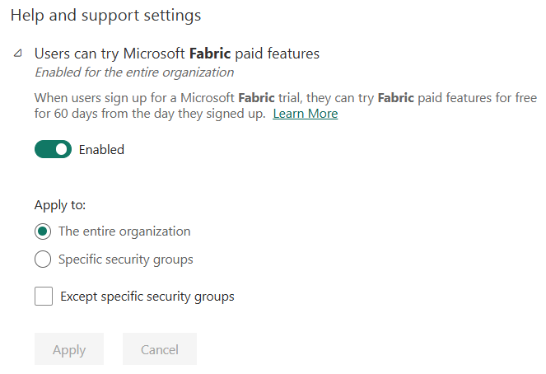
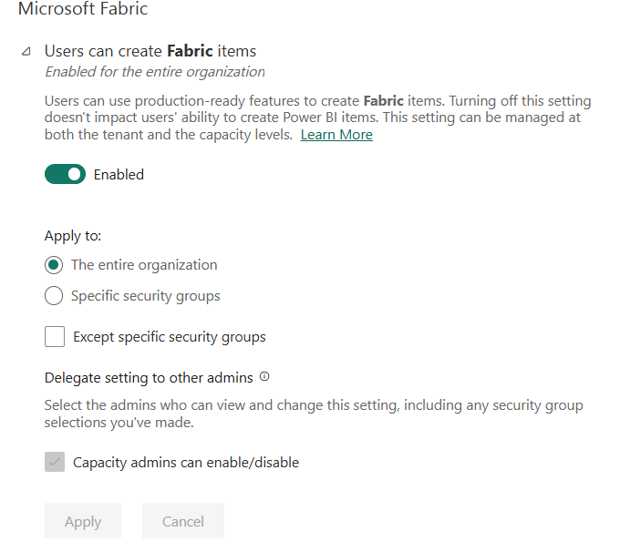
Create Fabric Objects

Slide 28
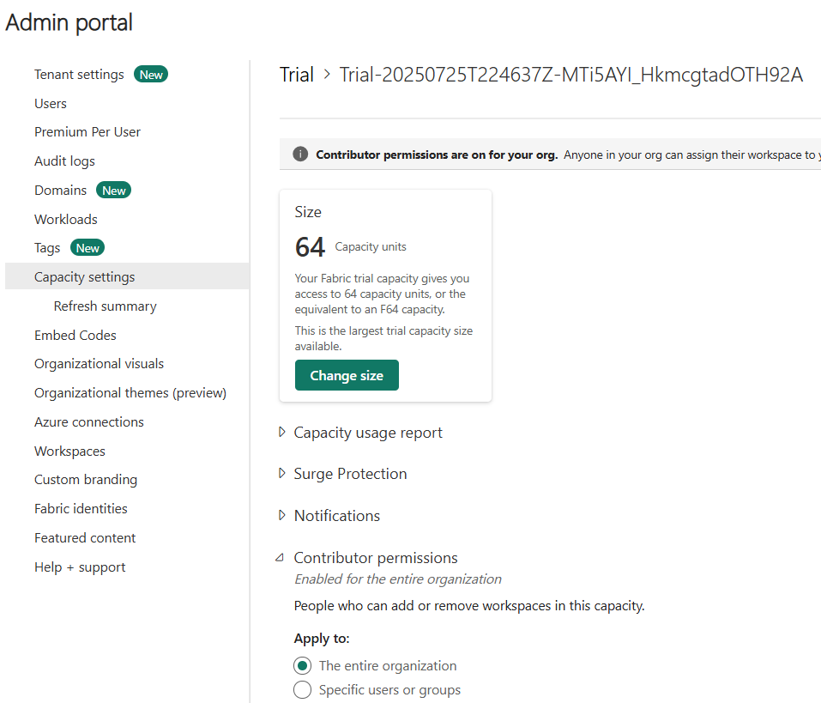
Capacity Permissions

Slide 29
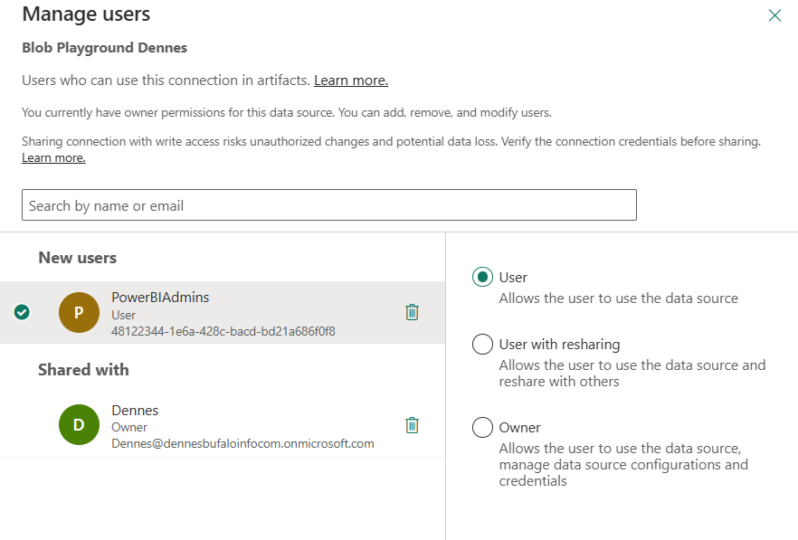
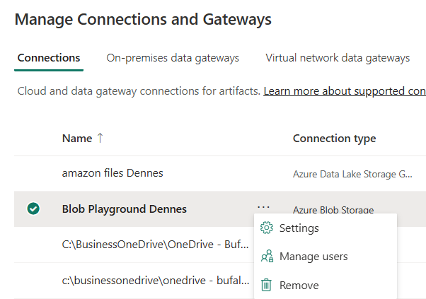
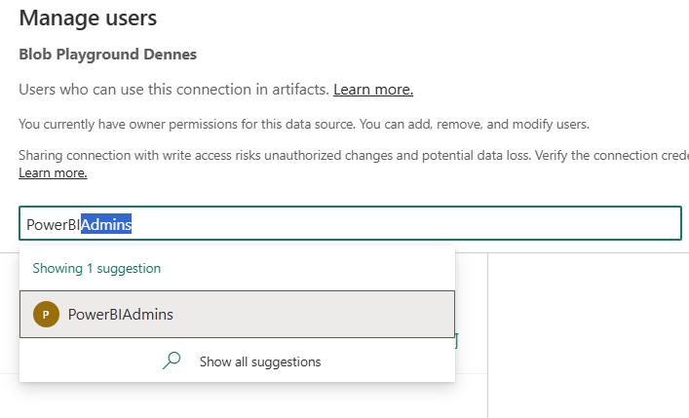
Connection Permissions

Slide 30
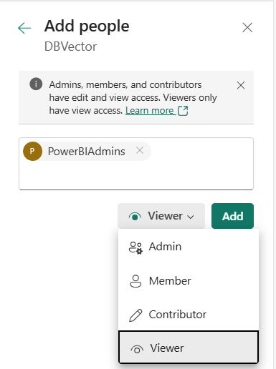
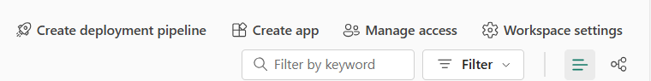
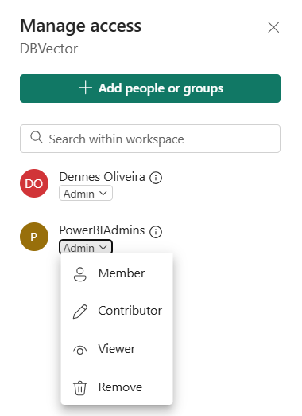
Workspace Permissions

Slide 31
Next Definitions
Define Company Domains
Control Delegated Security Definitions
Plan About Service Distribution

Slide 32
Service Distributions
Focused Datamarts
Data Product self-service services for Data Engineers
Data Product models and analysis for users

Slide 33
Plan about Master Data

Slide 34
Master Data
Shared data among multiple domains
Example: Countries, Cities, and more
Potential for data quality and integration problems
Example: côte d’ivoire, COTE D’IVOIRE, Ivory Coast
Master Data requires a team for a centralized Product
Requires enterprise-wide planning
Requires best practices definition

Slide 35
Business Examples
Hong Kong / China
Politically part of China, but often treated as a separate region for trade, tariffs, or port logistics.
Variations in naming: Hong Kong SAR, HK, Hong Kong, China.
Singapore / Johor Strait ports (Malaysia)
Close proximity of ports like Singapore and Malaysian Johor Strait ports causes ambiguity for loading/unloading points.
Some cargo manifests may refer to “Singapore” even if physically docked in Malaysia.
Caribbean islands
Many small islands (e.g., Sint Maarten, Bonaire, Curaçao, British Virgin Islands) have complex political statuses.
For business grouping, you may need to decide whether to classify by continent, customs territory, or shipping hub region.

Slide 36
Plan about Modelling

Slide 37
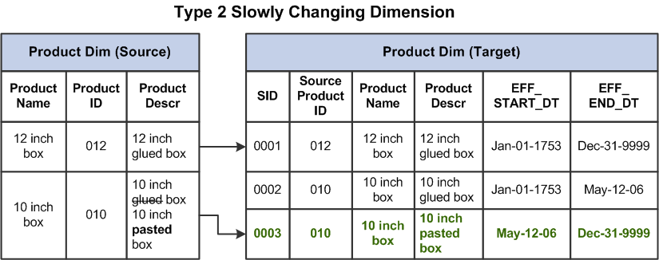
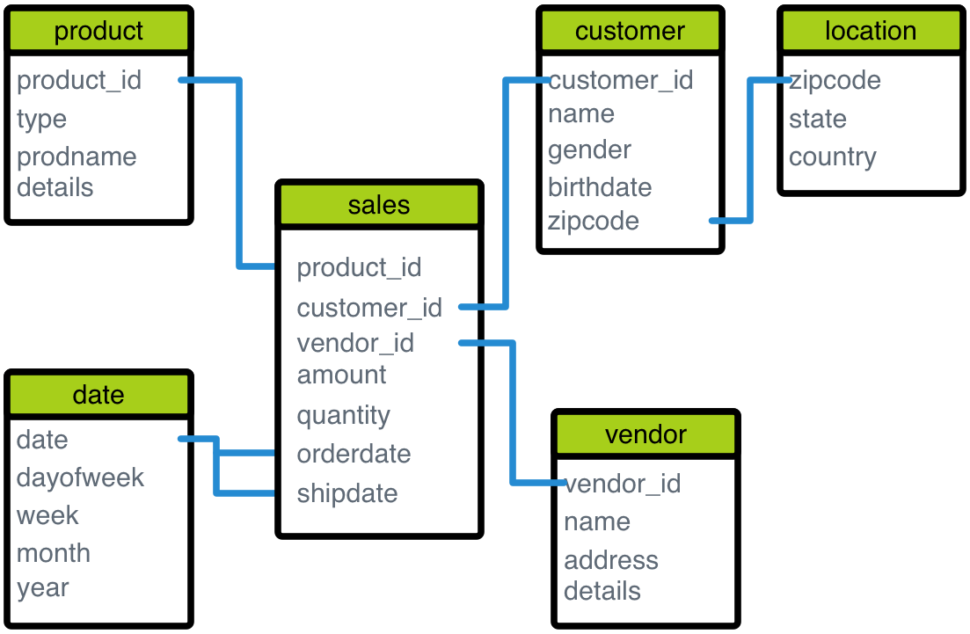
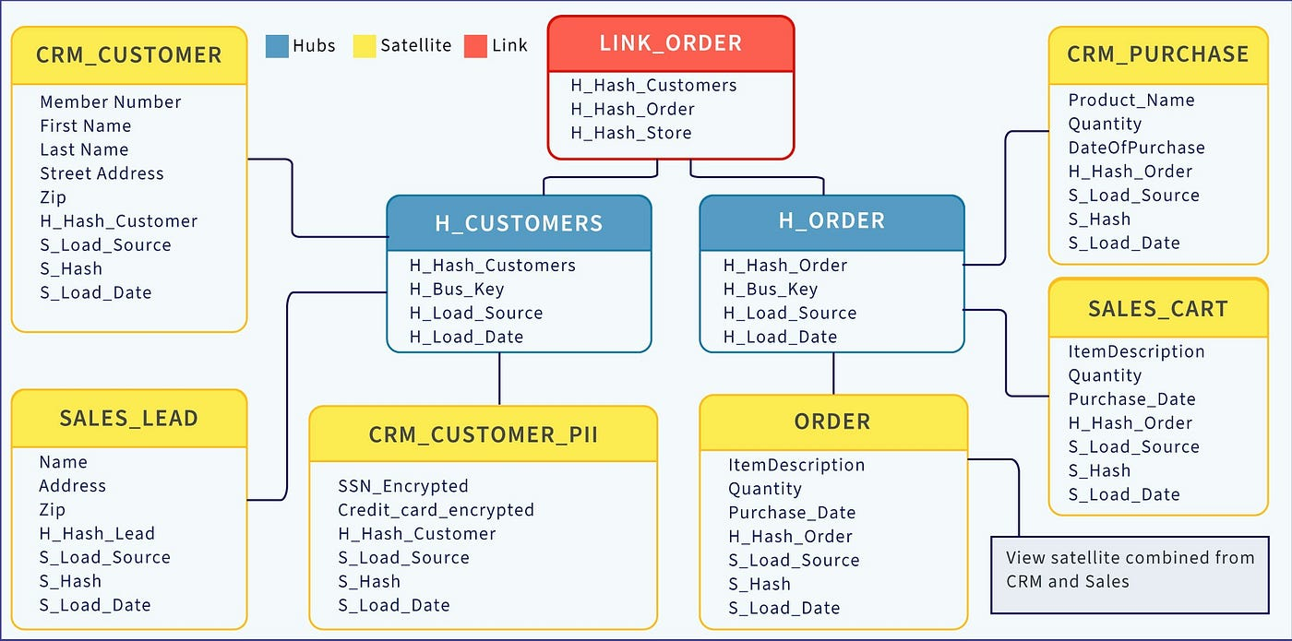
Modelling Plan
Data Vault
Star Schema
SCD Type 2

Slide 38
Modelling Plan
Best practices definition and guidance
Training

Slide 39
Supplier & Orders
Human Resources
Accounts & Invoices
Sales

Slide 40
Product Catalog and Endorsing

Slide 41
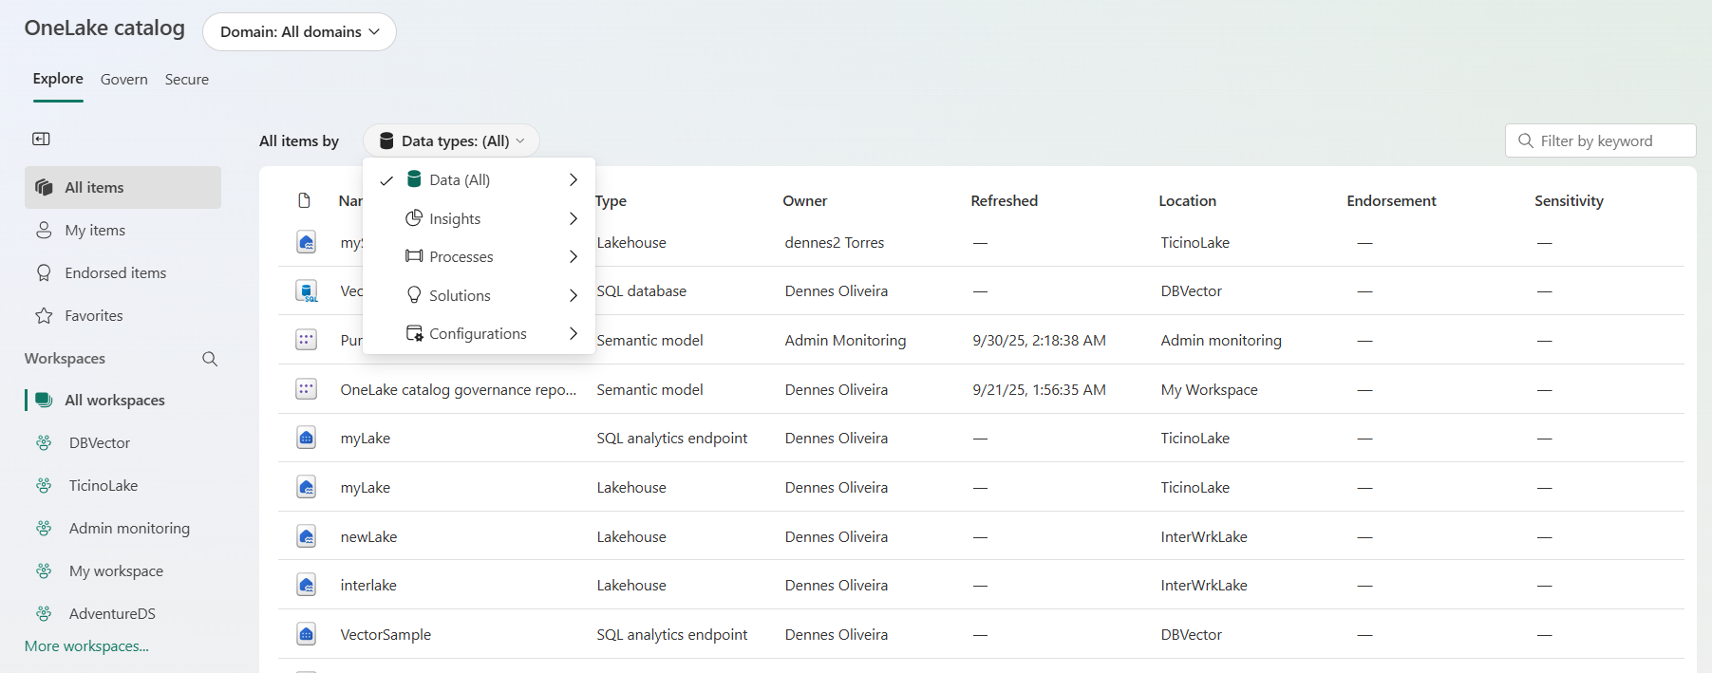
Product Catalog
Multiple types of filter to locate data

Slide 42
Endorsement
None (default)
The object is only visible to who has access to it
Promoted
The object is visible to everyone. Anyone without access can discover the object existence and request access
Certified
Promoted + The object is certified by a data steward as being correct
Master Data
A certified Master Data in the enterprise

Slide 43
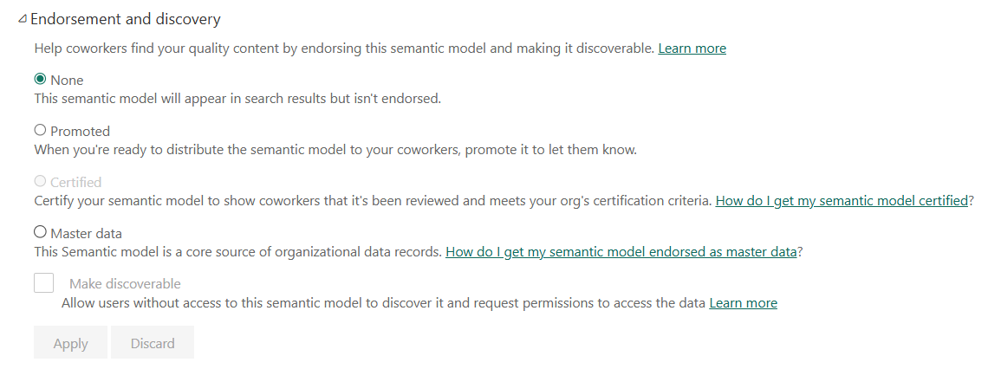
Configuration
Certified and Master Data requires a custom process

Slide 44
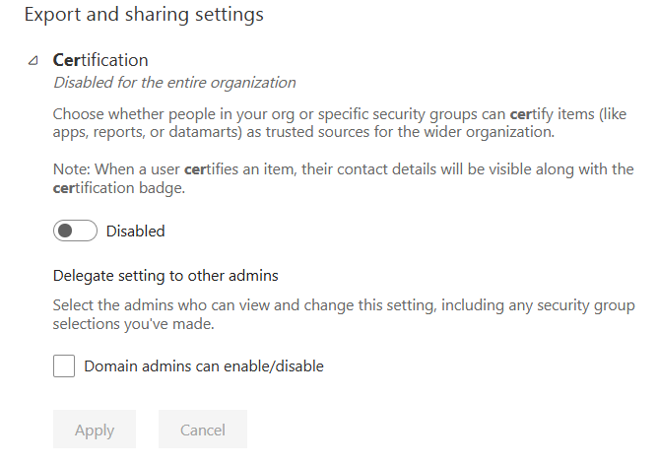
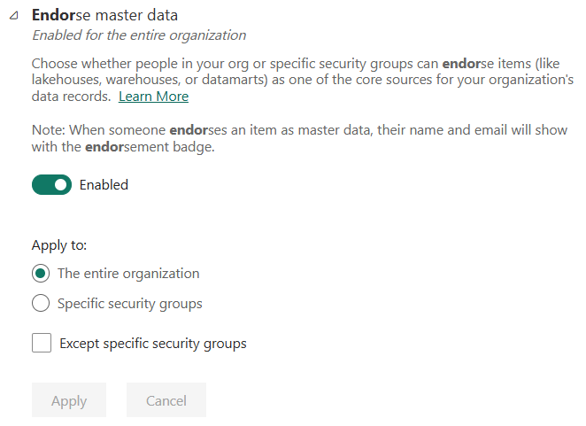
Certify and Master Data

Slide 45
Development Techniques and CI/CD

Slide 46
The Challenge
Data Professionals <> CI/CD
DevOps Professionals <> Data

Slide 47
What You Need
Establish the process
Test the process
Document the process
Train the team on the process

Slide 48
Summary
Understand the Scope
Choose the Architecture
Define the Company Domains
Plan for Delegated Security & Central Team
Plan Master Data Implementation
Plan Modelling Techniques
Plan Endorsing and Master Data Process
Plan Development Process

Slide 49
This is only the beginning

